Slide 1
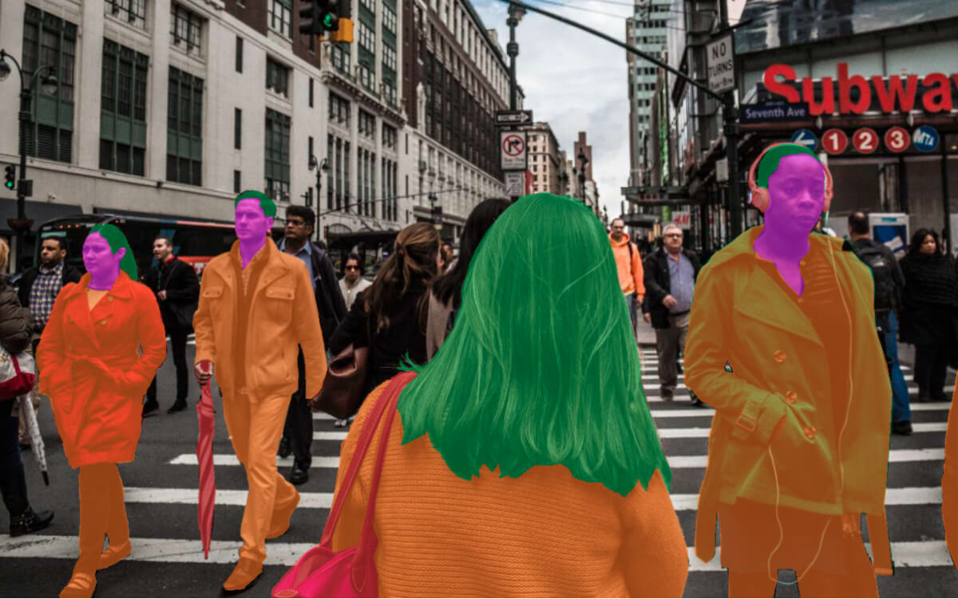
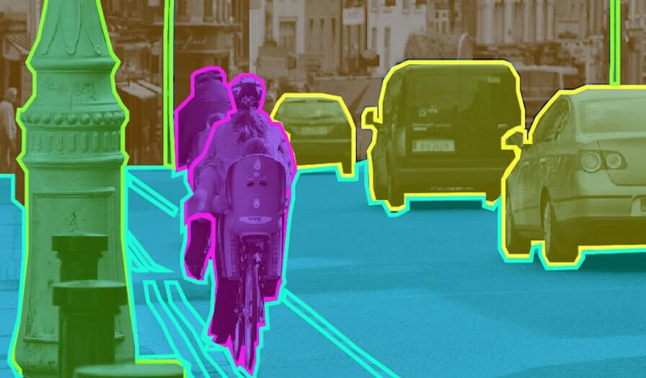
GAN-Based Semantic Segmentation Enhancement for Complex Scenes in ADE20K
Team Team
Chenlin Li (z5527155)
Haitao Wu (z5516805)
Junwei Zhang (z5448642)
Yuji Mao (z5522942)
Zhongtao Du (z5504303)

Slide 2
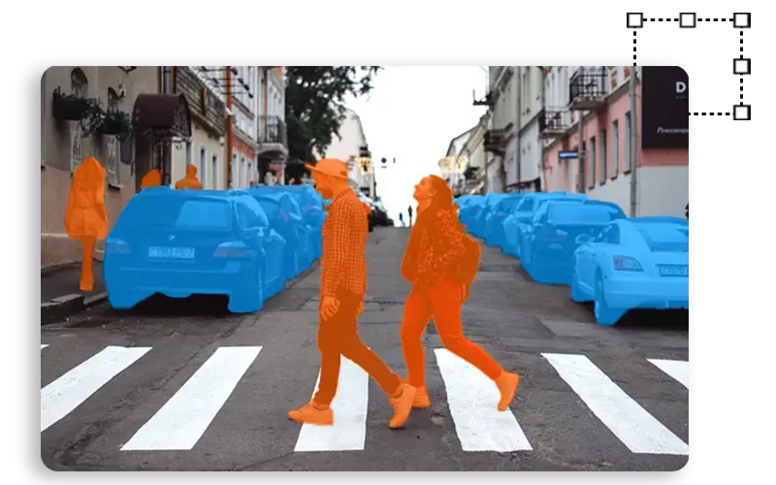
Motivation
Semantic segmentation: Enhancing pixel-level interpretation for precise scene understanding through refined semantic segmentation
One of the core tasks in computer vision
Broad array of applications:
Medical Image Analysis
Satellite Image Analysis
Augmented Reality (AR)
Autonomous Vehicles
Robotics
Agriculture
…
Presenter: Yuji Mao (z5522942)

Slide 3
Problem Statement
How to improve semantic segmentation performance in complex scenes using deep learning techinques GANs by refining segmentation maps to capture fine-grained details and handle challenging conditions comparing to traditional thresholding method (watershed) and simple machine learning approach (CNN)?
Presenter: Yuji Mao (z5522942)

Slide 4
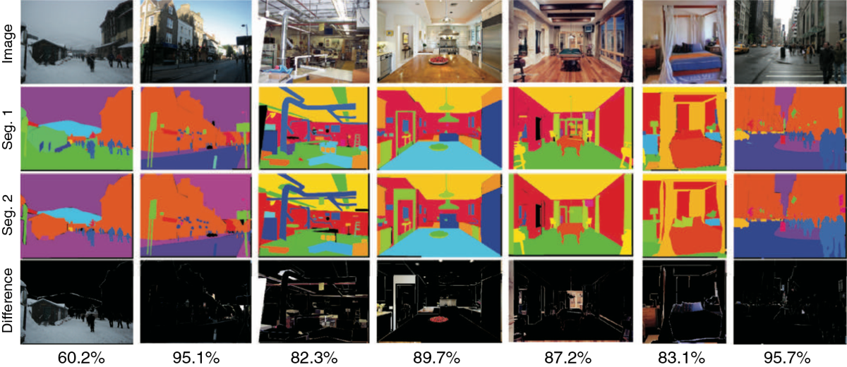
Dataset – ADE20K
The ADE20K dataset contains over 25,000 annotated images across diverse indoor and outdoor scenes, with over 150 object and stuff classes. This dataset is notable for its densely labeled images, providing pixel-wise annotations that span object parts, making it ideal for semantic segmentation and scene parsing tasks in complex environments.
Presenter: Yuji Mao (z5522942)

Slide 5
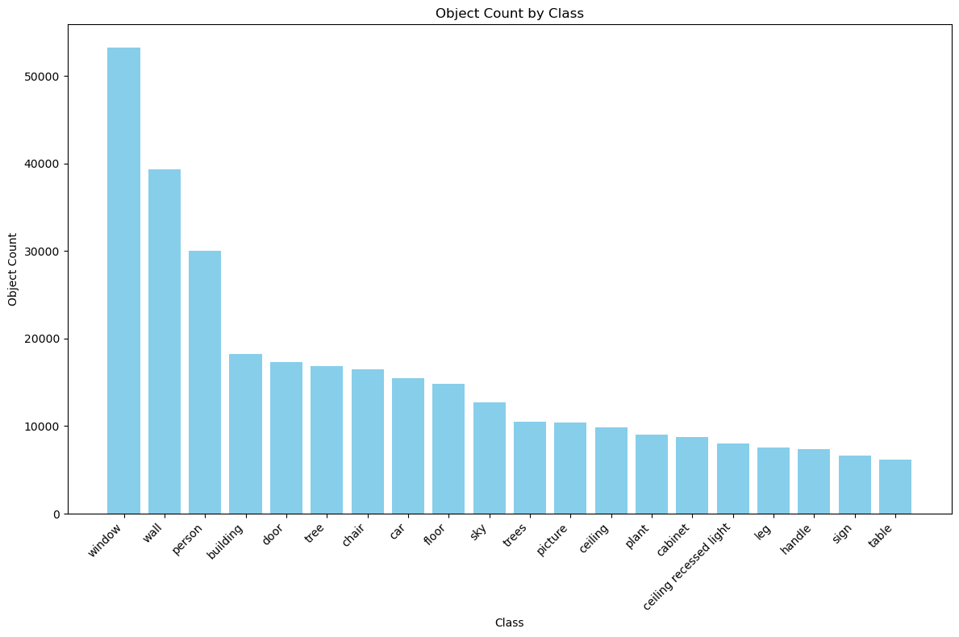
Data Analysis
Densely Annotated Images:
Every pixel is semantically labeled, detailed segmentation with diverse and unrestricted classes
Wide Coverage:
Allowing for more comprehensive training with its wide range of object components, scenes, and categories
Independent Object Instances:
Each instance is independently segmented, enhancing scene parsing and object understanding
Advances Scene Parsing:
Detailed and contextually accurate annotations
Limitations of Other Datasets:
limited object classes, narrow vocabularies, and noisy labels, making training difficult
Presenter: Yuji Mao (z5522942)
Notes:
Details of the dataset, no. of images, class, what the data are alike apprt from the images, segments, class， any study have been done using the dataset

Slide 6
Literature Review
1. Abdollahi, Abolfazl, et al. "Improving road semantic segmentation using generative adversarial network." IEEE Access 9 (2021): 64381-64392.
This paper explores the use of a generative adversarial network (GAN) in enhancing the accuracy of a deep learning approach, targeting road semantic segmentation from high-resolution aerial images. The authors propose a modified U-Net architecture with an integration of a GAN framework to enhance the quality of segmentation maps for higher resolution and better edge preservation. Their model is stained on the Massachusetts road dataset, which performed better at generating smoother and more precise road networks comparing to previous CNN-based techniques. Their approach especially resolved the challenges of shadows and occlusions, resulting from significant improvements such as precision, recall, and F1-score.
This study highlights the effectiveness of GANs in overcoming common limitations in semantic segmentation tasks, making it highly relevant for projects dealing with complex road segmentation issues. It shed lights on out project for its focus on edge persecution and high-resolution segmentation, which would be applicable when we handle challenges such as occlusion and varying lighting conditions.
Presenter: Yuji Mao (z5522942)
Notes:
Table with literature cited (paper, main idea, what can we get from it)

Slide 7
Literature Review
2. Zhang, Chaoyi, et al. "MS-GAN: GAN-based semantic segmentation of multiple sclerosis lesions in brain magnetic resonance imaging." 2018 Digital Image Computing: Techniques and Applications (DICTA). IEEE, 2018
This study introduces MS-GAN as a novel semantic segmentation framework at the time. The study was generated based on generative adversarial networks (GANs) to help detect multiple sclerosis (MS) lesions in multimodal brain MRI scans. The authors presented the challenge of high variability in MS lesion characteristics by proposing a unique architecture. The framework they addressed combines multimodal encoder-decoder generator with spatial information bypass, along with various discriminators corresponding to different input modalities. A classification-related constraint for improved adversarial training has also been added to the architecture.
The research demonstrate that MS-GAN outperforms state-of-the-art techniques in terms of segmentation accuracy. The key findings presented in this paper integrates multimodal imaging data through multi-path encoding and cross-modality fusion, featuring evaluation on a substantial dataset of 126 cases from relapsing MS patients. Additionally, comparative analysis has been conducted with other semantic segmentation models and patch-based deep learning methods to validate their result. This paper is significant for researchers working on medical image analysis, particularly those focusing on MS lesion detection and segmentation in multimodal MRI data. This study's offers insights into GAN's adaptability for real-world noisy environments for our project.
Presenter: Yuji Mao (z5522942)

Slide 8
Methodology
Watershed
CNN
GAN
Presenter: Yuji Mao (z5522942)
Notes:
Compare results, mean IoU

Slide 9
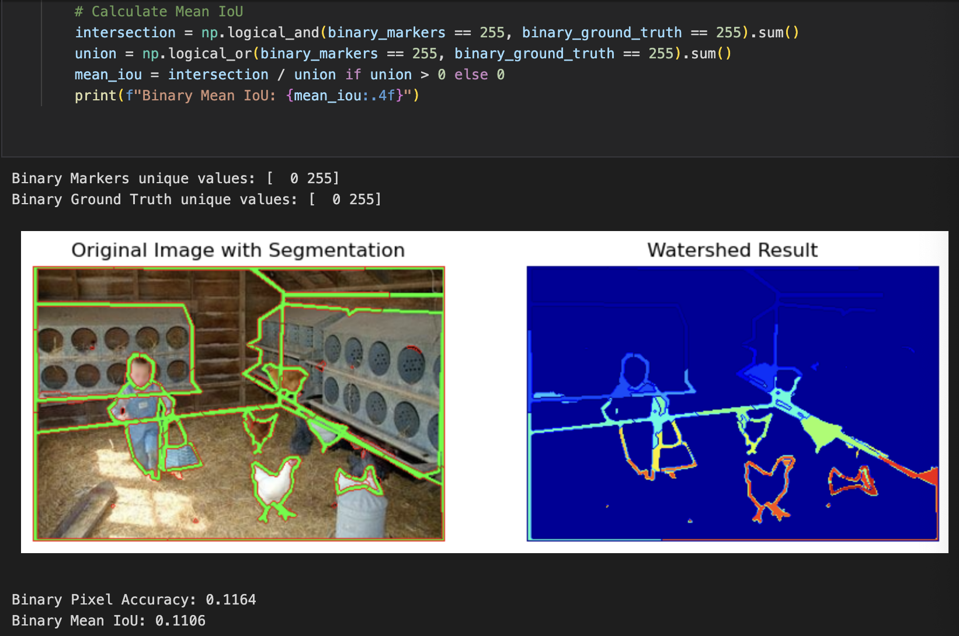
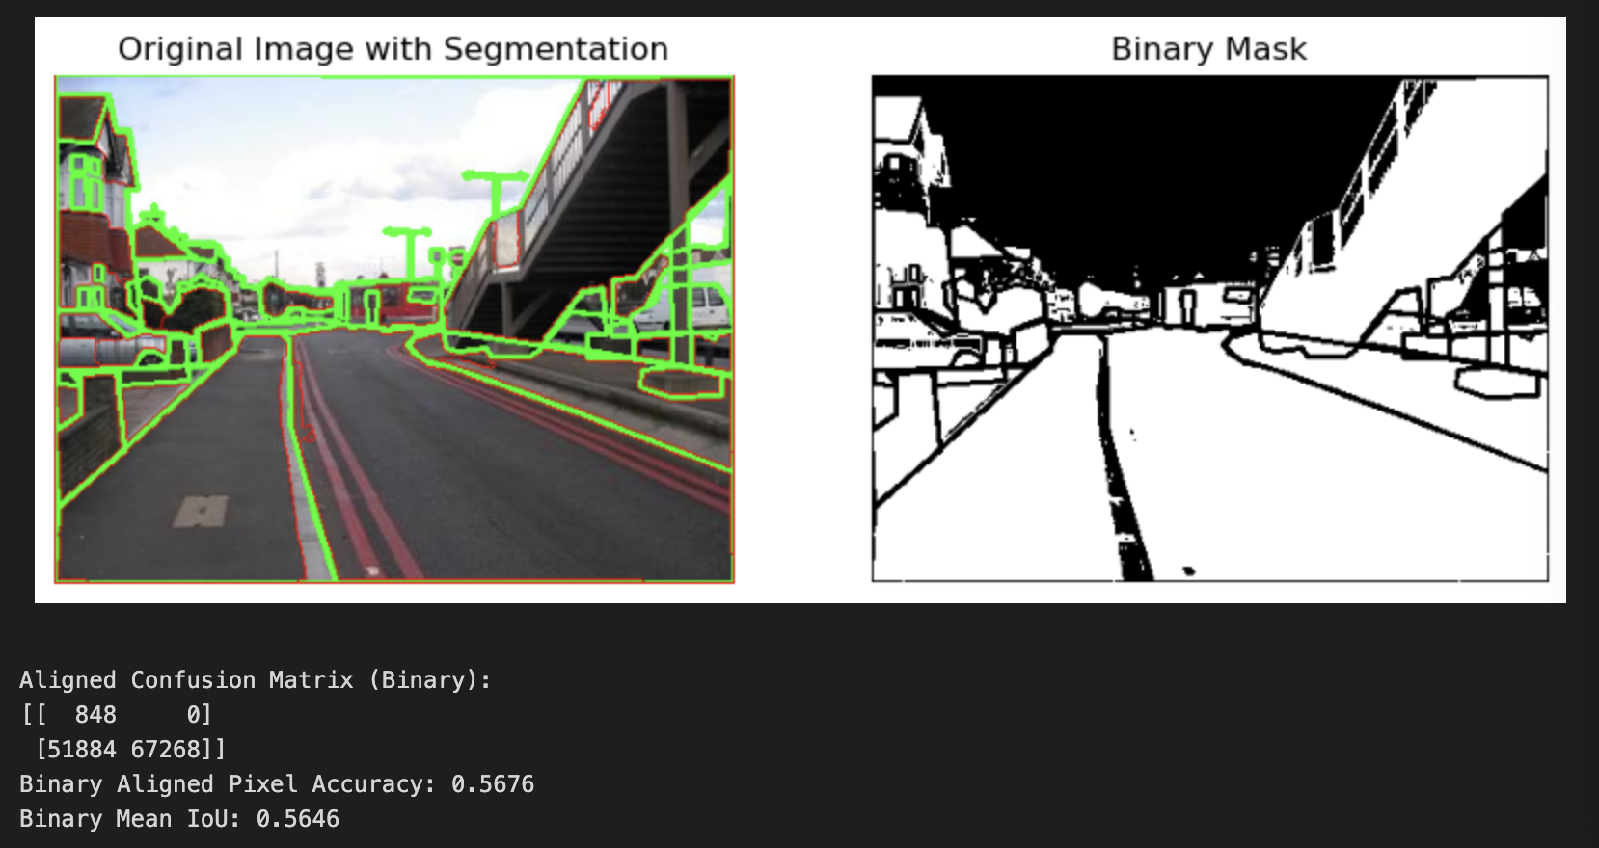
Method – Basic Watershed Thresholding
Image Preprocessing:
Convert image to grayscale
Apply Otsu thresholding to create a binary mask separating foreground & background
Distance Transformation:
Define distances to the nearest background pixel on the binary mask
Threshold the distance transform to determine the sure foreground
Background and Unknown Regions:
Expand Background: Dilation
Refine Foreground: Erosion
Identify Unknown Areas: Subtract the refined foreground from the background
Presenter: Junwei Zhang (z5448642)

Slide 10
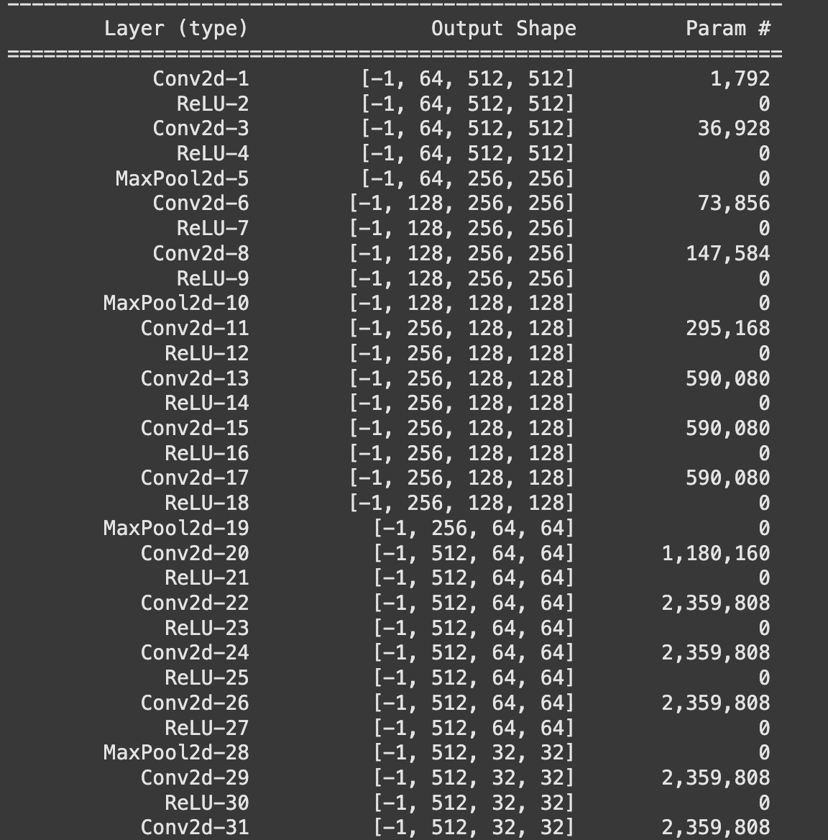
Method – Simple CNN
Our Model
Decoder
We use Fully convolutional model with U-net structure. It has five
convolutional blocks and use Relu activation function.
Fully connected layer
Three convolutional layers simulate fully connected layer. It reduce
the number of channels at the last convolutional layer to match the
number of classes.
Encoder
In the encoder section, we use three transposed convolutional layers to upsample the feature
maps back to the original size. The model also uses skip connections to add intermediate feature maps from the encoder to the corresponding decoder stages.
Presenter: Chenlin Li (z5527155)

Slide 11
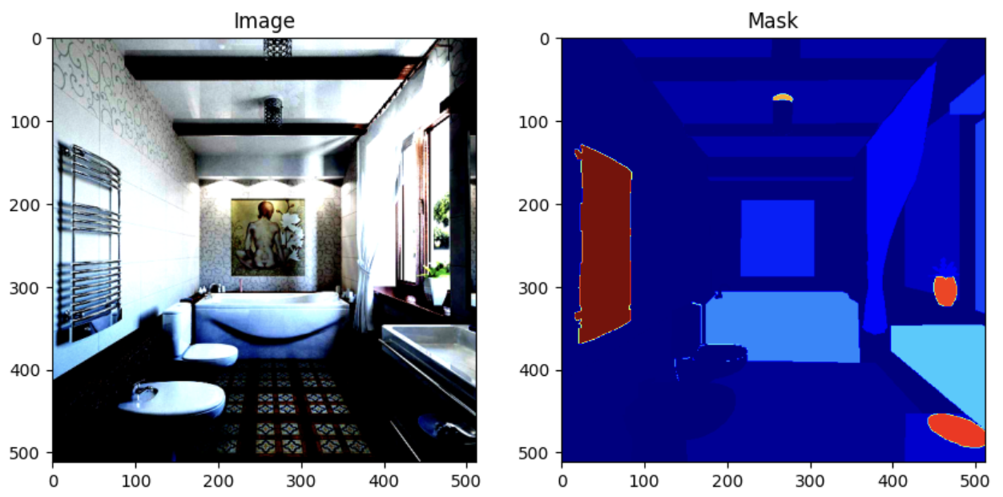
Method – Simple CNN
Our Preproccessing
There are more than three thousand classes in our dataset,
we decided to choose the top 150 categories. This reduces
both the training time and the data loading time.
We also apply a series of image preprocessing steps. Firstly,
we designed a function for generating masks from annotated
objects file by filling different areas with their class numbers.
Secondly, We resize all the images and masks into 512* 512, which is our model input size. Thirdly, we apply both the augmentation and standardization to the images.
Our Training
Because this is a multiple-class prediction task, we use Cross Entropy Loss during training and set the dropout to 0.5 to prevent overfitting. Since this is a complex task, we use a small learning rate of 1e-5.
Presenter: Chenlin Li (z5527155)
Notes:
w/ vs w/o linear layers, compare baselines + parameters

Slide 12
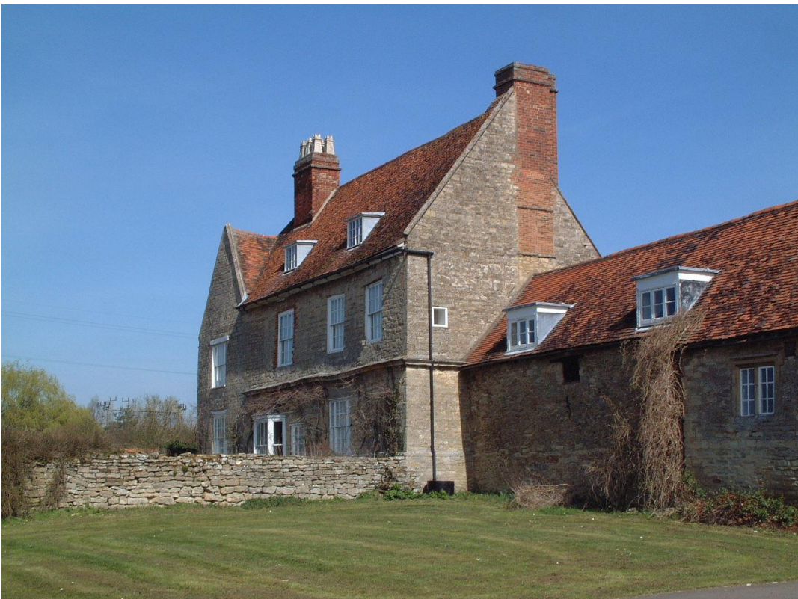
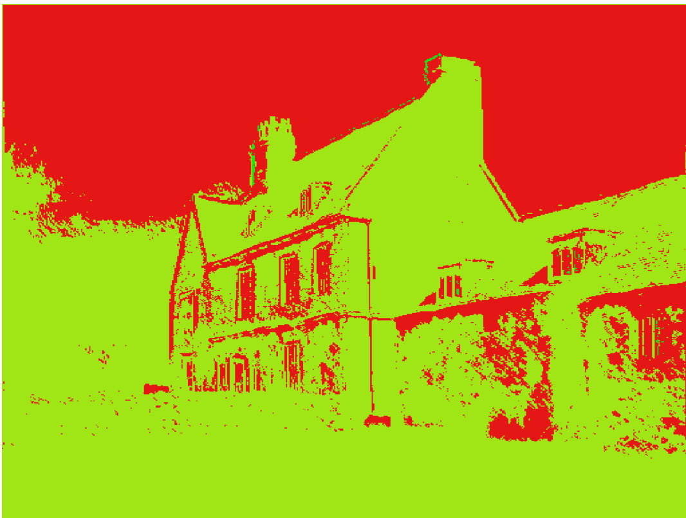
Method – Deep Learning GAN
In the field of image segmentation, GAN improves the accuracy of image segmentation with a unique generative adversarial mechanism, especially in the boundary segmentation region, we use VGG16, which is similar to CNN, as the generator, with the addition of a discriminator and a training loop.
- Generator:
The generator defines a U-Net variant based on a VGG16 encoder. This model uses an encoder-decoder architecture to extract image features and progressively restore spatial resolution, resulting in a segmentation mask of the same size as the input image.
Presenter: Zhongtao Du (z5504303)

Slide 13
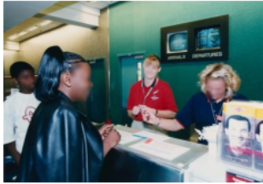
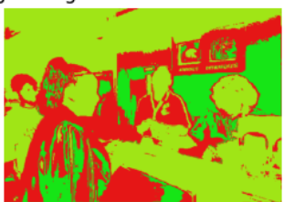
Method – Deep Learning GAN
- Discriminator：
The discriminator has three convolutional layers, each with increasing filters and dropout for regularization. The model uses convolutions with Leaky ReLU activations and batch normalization. The final layer outputs a single-channel prediction map.
- Train loop:
Define the cross entropy loss function and stochastic gradient descent (SGD) optimizer, set the number of training epochs. Train the data 30 times, perform forward propagation, calculate loss, backpropagation and parameter update for each training, and print the loss of each batch.
Presenter: Zhongtao Du (z5504303)

Slide 14
Results
Method/model | mIoU(Mean Intersection over Union)
Basic Watershed Thresholding | 0.1164
FCNN | 0.2437
cGAN | 0.3324
Presenter: Haitao Wu (z5516805)

Slide 15
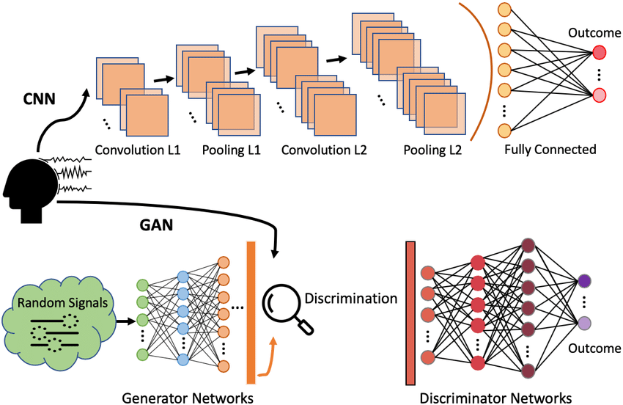
Discussion
Why GAN can perform better than FCNN?
Enhanced Realism Through Adversarial Loss
discriminator
adversarial training process
Detailed Boundary and Edge Refinement
Avoid Overfitting
dropout
Presenter: Haitao Wu (z5516805)

Slide 16
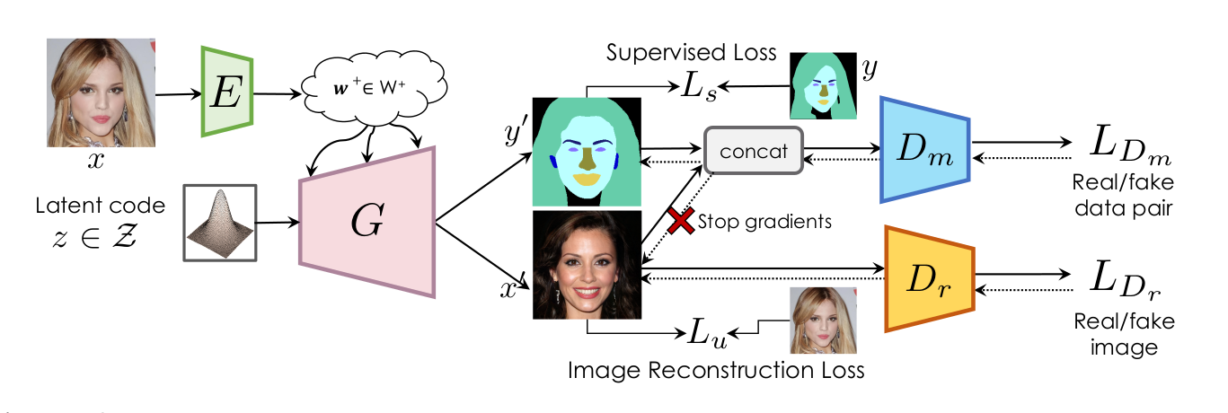
Conclusion
Over these three models, the GAN perform the best
What can we improve if we have more time?
Improved Discriminators(PatchGAN discriminators)
Incorporate Attention Mechanisms
Data Augmentation
Presenter: Haitao Wu (z5516805)

Slide 17
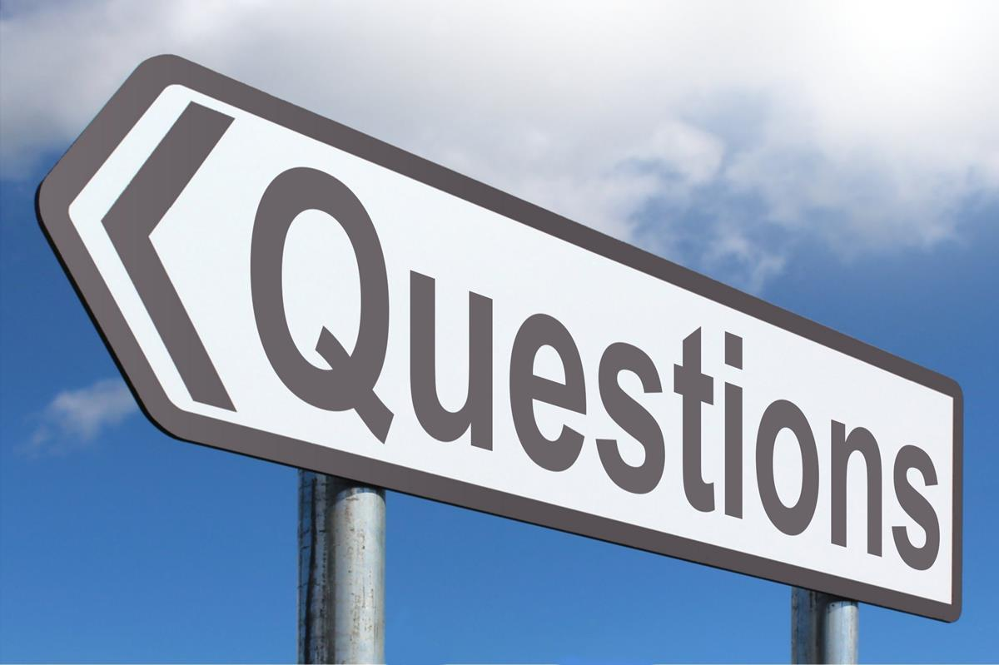
Thank you for your attention!
This Photo by Unknown Author is licensed under CC BY-SA

